Slide 1


Slide 2
HydroHub
H.A.M. Tech
Final Presentation
EG-1003 i²e
25 April 2018
Helal Chowdhury, Abe Thomas, Min Kim

Slide 3

H.A.M. Tech
Founded February 2012
Company Goal
Provide the means to keep people healthy using myriad technological innovations
H.A.M. Tech | Helal Chowdhury, Abe Thomas, Min Kim

Slide 4


H.A.M. Tech
Previous Achievements
Zero calorie soda
Water filtration straw
Clients
United States Department for Health and Human Services
H.A.M. Tech | Helal Chowdhury, Abe Thomas, Min Kim

Slide 5



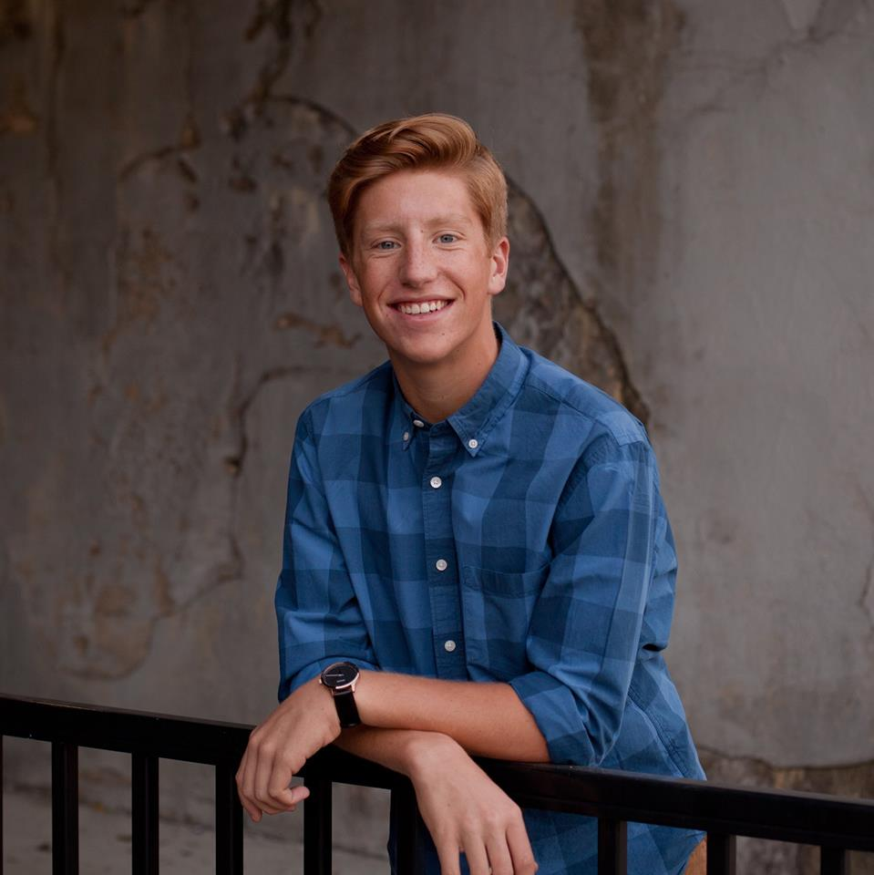
Helal Chowdhury
Min Kim
Abe Thomas
Chief of Hardware & Circuitry
BS/MS Electrical Engineering
Chief of Programming & Development
BS/MS Computer Science
Chief of Design & Production
BS/MS Mechanical Engineering
H.A.M. Tech | Helal Chowdhury, Abe Thomas, Min Kim

Slide 6

Recommended for Men
15.5 Cups
Recommended for Women
11.5 Cups
Average Water Intake
4.5 Cups
H.A.M. Tech | Helal Chowdhury, Abe Thomas, Min Kim

Slide 7


H.A.M. Tech | Helal Chowdhury, Abe Thomas, Min Kim

Slide 8
Goal For Project HydroHub
Track water intake in an efficient and innovative way for sufficient daily water consumption
H.A.M. Tech | Helal Chowdhury, Abe Thomas, Min Kim

Slide 9

Track water consumption
Display measured data
Easily stored when not being used
Measure quality of water for comfortable drinking
Temperature Sensor
Flow sensor inside bottle
LCD screen embedded in bottle
Horizontal base
H.A.M. Tech | Helal Chowdhury, Abe Thomas, Min Kim

Slide 10
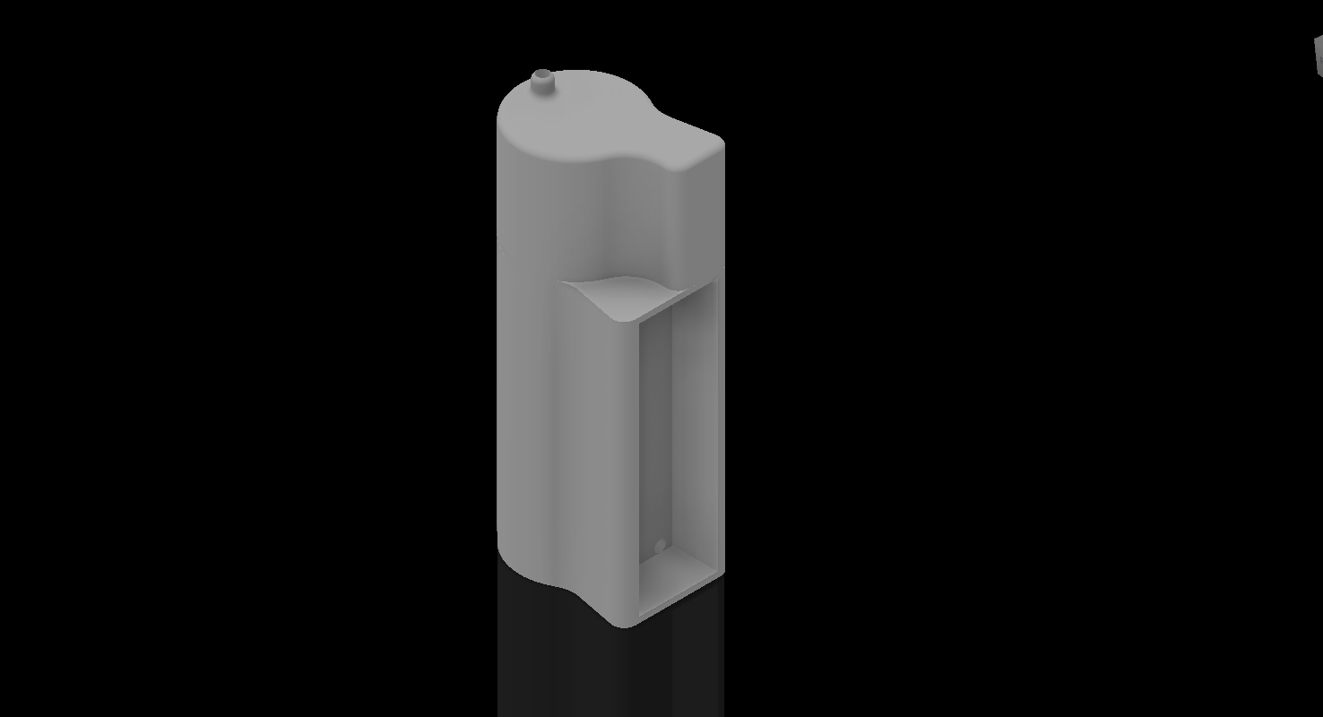
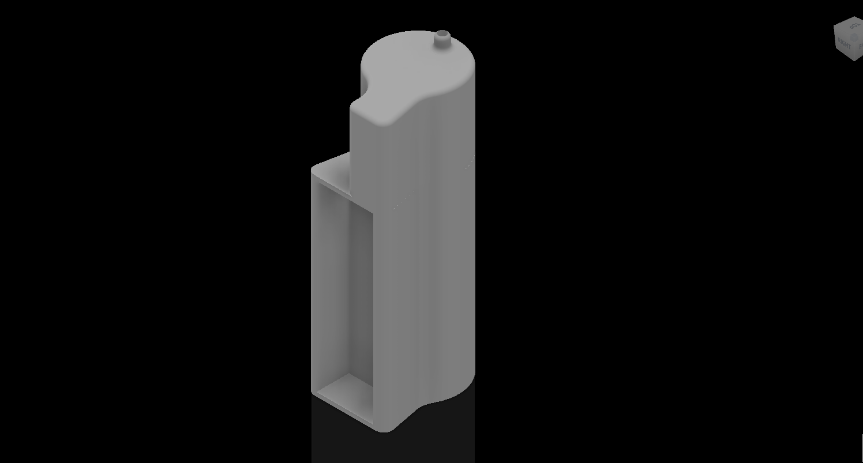
PROTOTYPE DESIGN
H.A.M. Tech | Helal Chowdhury, Abe Thomas, Min Kim

Slide 11
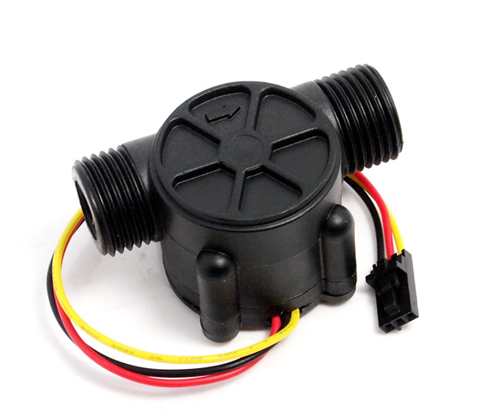
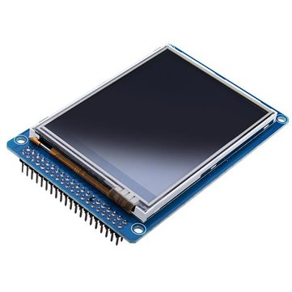
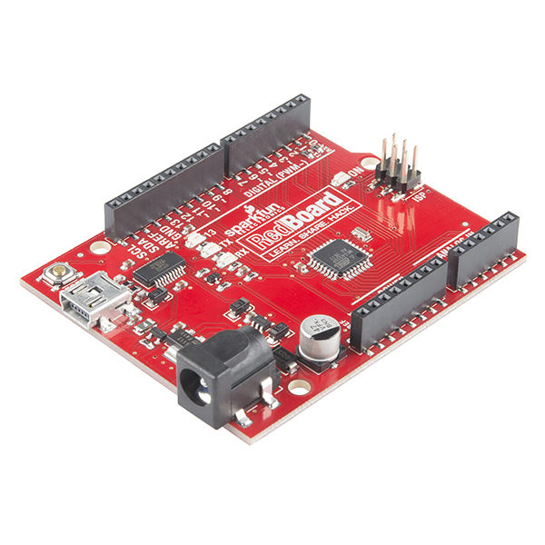

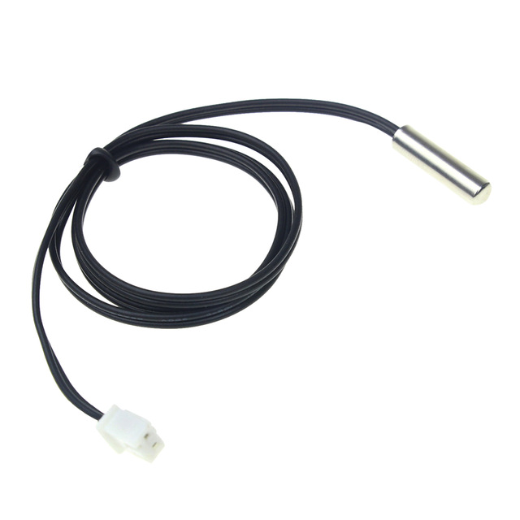

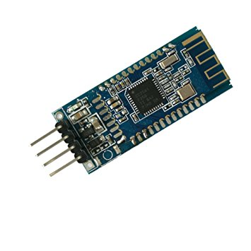


LCD Display
Flow Meter
Arduino Board
Users
Thermistor
Smartphone App
Bluetooth
H.A.M. Tech | Helal Chowdhury, Abe Thomas, Min Kim

Slide 12
CURRENT COST
Item/Employee | Quantity | Unit Cost | Cost
Flow Meter | 1 | $9.88 | $9.88
Labor | 3 | $50 / hour | $18,000 / 120 hours
Total | $18,009.88
H.A.M. Tech | Helal Chowdhury, Abe Thomas, Min Kim

Slide 13
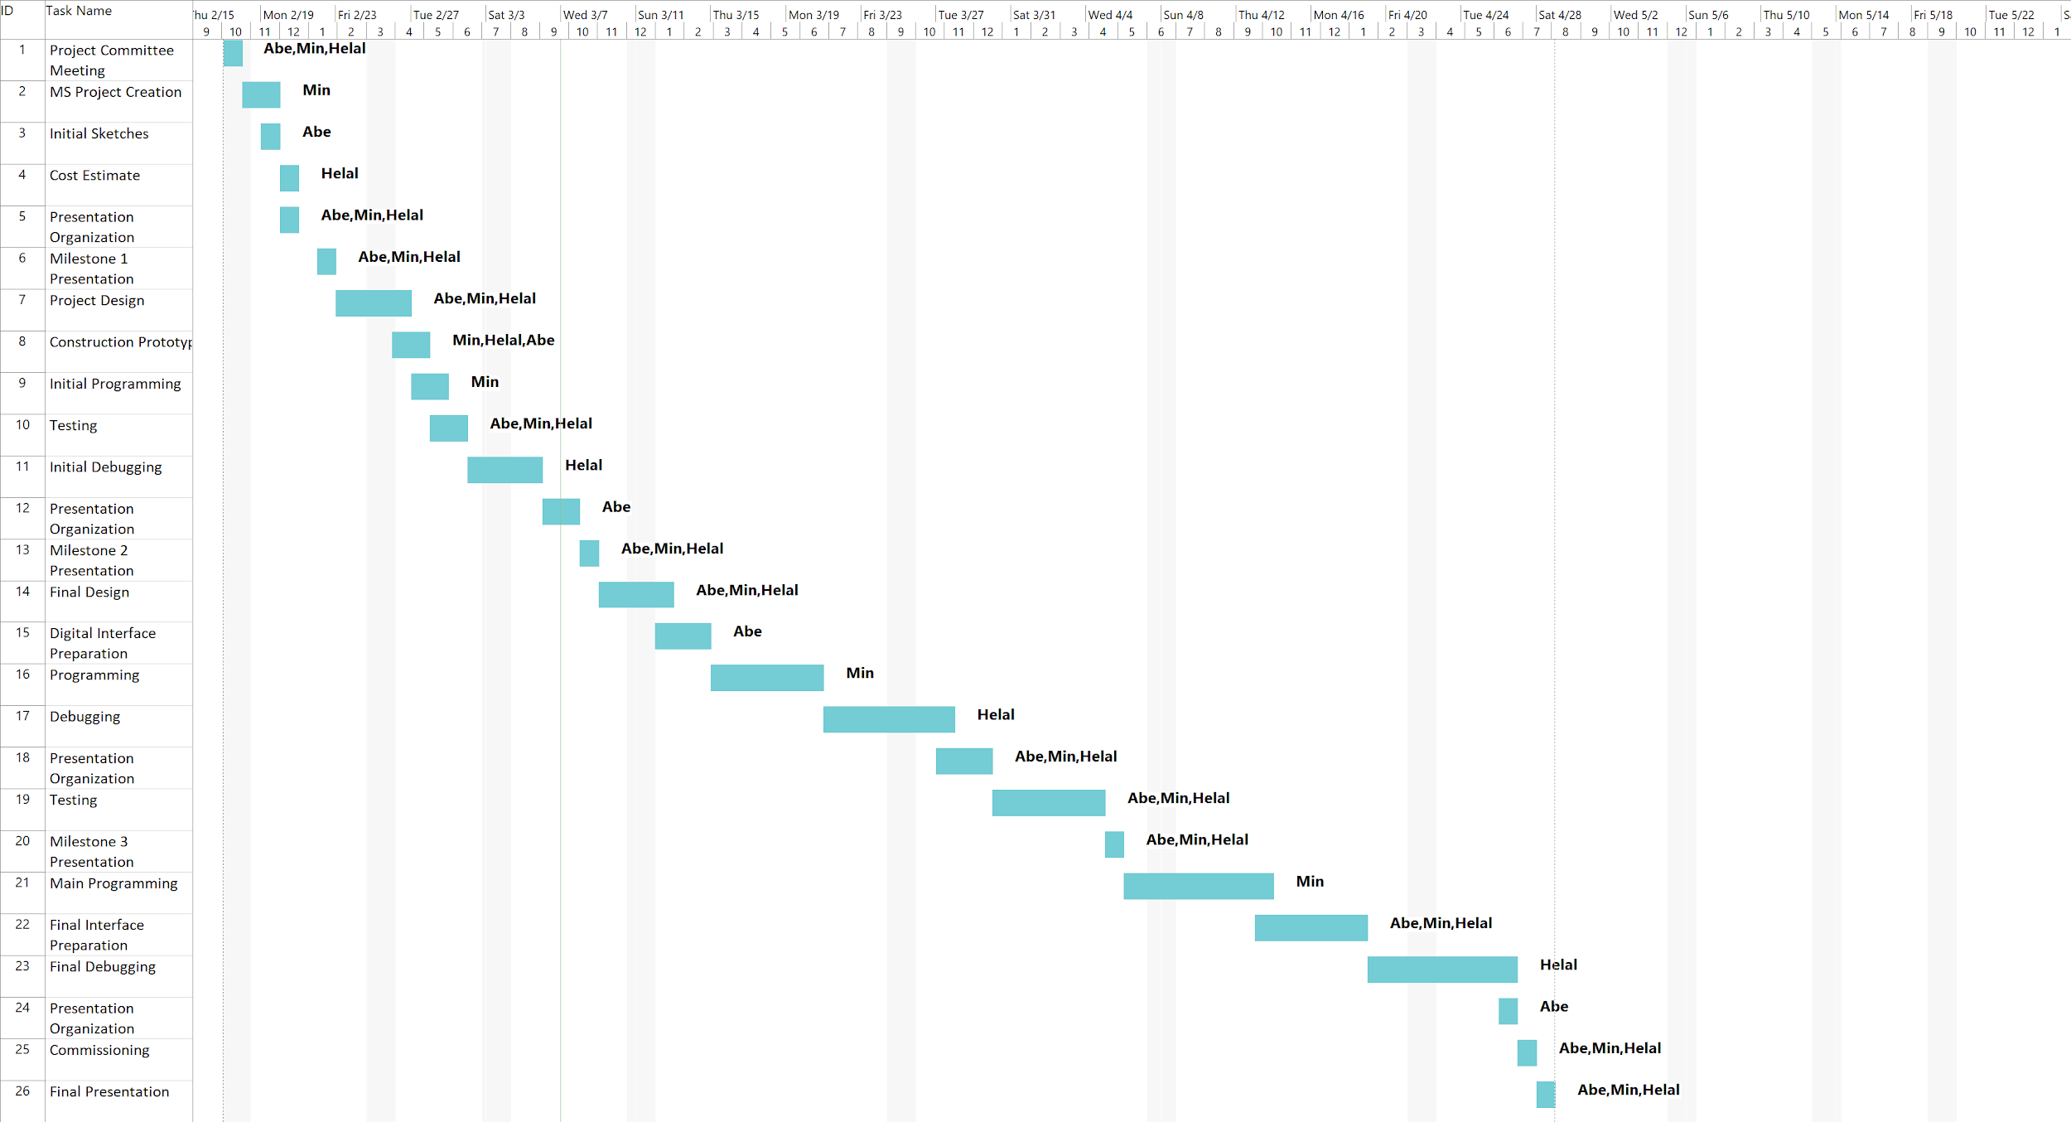
H.A.M. Tech | Helal Chowdhury, Abe Thomas, Min Kim

Slide 14
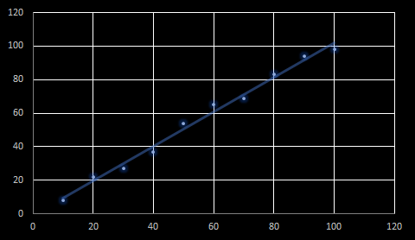
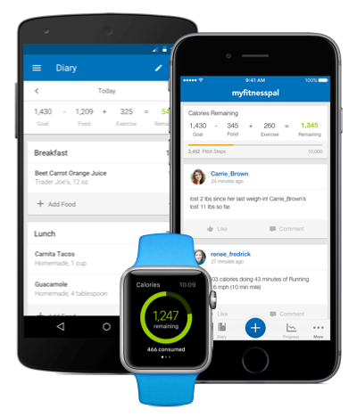

Why HydroHub?
HIGH PRECISION
LOW COST
COMPETITION
98.05% ACCURACY
$$$
Recorded Volume (mL)
Actual Volume (mL)
H.A.M. Tech | Helal Chowdhury, Abe Thomas, Min Kim

Slide 15
DESIGN
FUNCTIONALITY
Utilize PCB and Arduino Mini
Embed an interactive display
FUTURE IMPROVEMENTS
Minimize size and create more comfortable grip
Allow users to set goals and give frequent alerts
Create a cylindrical structure
Display time, weather and water purity
H.A.M. Tech | Helal Chowdhury, Abe Thomas, Min Kim
H.A.M. Tech | Helal Chowdhury, Abe Thomas, Min Kim
H.A.M. Tech | Helal Chowdhury, Abe Thomas, Min Kim

Slide 16
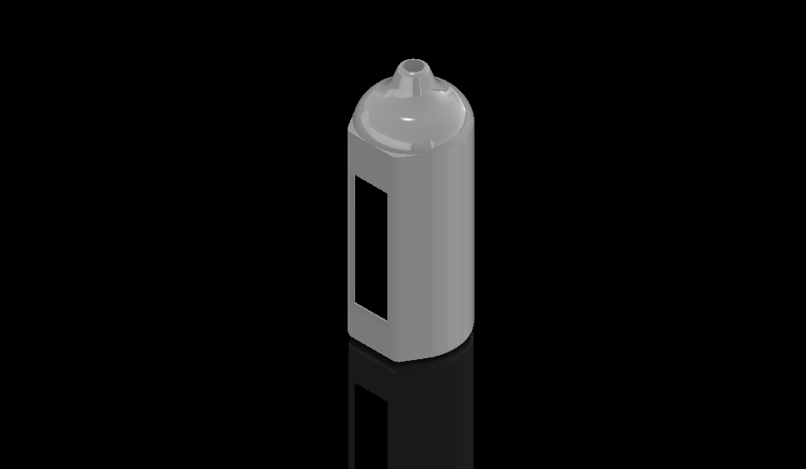
FUTURE DESIGN
Water Purity Sensor
Smart Code:
Learns Users’ Habits
Gyroscopic Sensor
Stylistic Design
H.A.M. Tech | Helal Chowdhury, Abe Thomas, Min Kim

Slide 17
Customer Rating
HydroHub vs. Competitors
Total Units Sold
99.7%
98,276
H.A.M. Tech | Helal Chowdhury, Abe Thomas, Min Kim

